Slide 1
Automation Architecture*
(mobile example)
TypeScript
Gennadii Mishchevskii
09/2018

Slide 2

Part 0: whoami
Gennadii Mishchevskii
Senior Automation QA Engineer at Ciklum
4 years in the industry
Automated back-end, front-end and mobile
https://www.linkedin.com/in/gennadiimishchevskii/

Slide 3

Part 0: Agenda
1 - What do we want to achieve
2 - What do we need to have
3 - How do we trigger test run
4 - Abstraction layers
5 - Element Finder
6 - Waiters
7 - How to fight platform differences without “if” on each line
8 - Dynamic imports
9 - How to check that page opened
10 - Automate automation
means problem
code to focus on

Slide 4
Part 0: Warm-up (wait until the end for explanation)
NaN === NaN
1 < 2 < 3
false
true
0.2 + 0.1 == 0.3
3 > 2 > 1
false
false
0.15 + 0.15 == 0.3
[] == []
true
false
0,5 + 0,5
[] == ![]
5
true

Slide 5
Part 1: What do we want to achieve
First of all code should be flexible and extensible and only then working
Code should be stable
Code should be maintainable

Slide 6
Part 2: What do we want to have (not exactly about architecture but still...)
Code style (“ or ‘) - the main thing is not to fight about it
Linter - the later you add it the more changes you will have to do
Reporters (including screenshot and video reporters)
Logger
Do we want separate tests for different platforms?

Slide 7

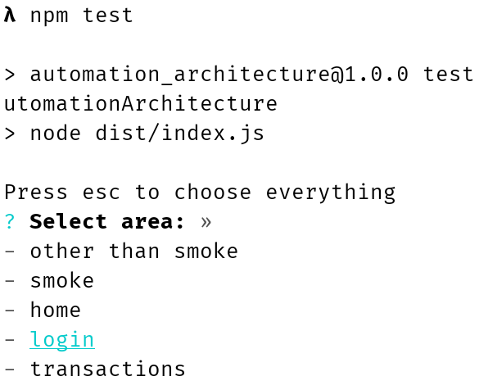
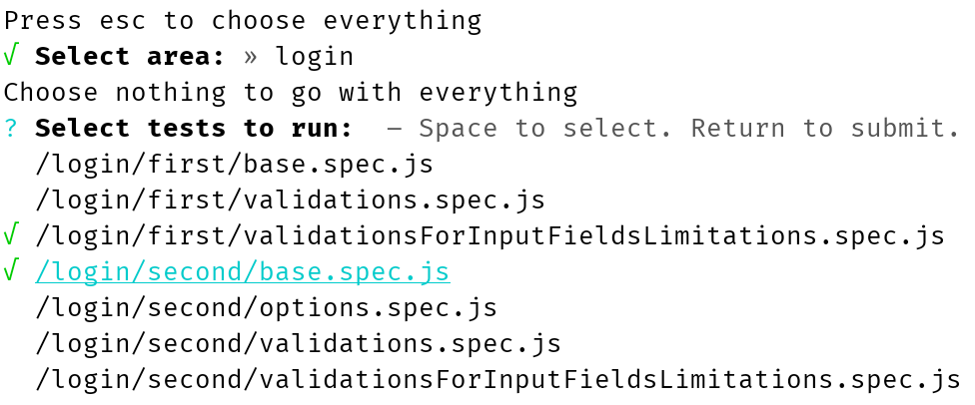
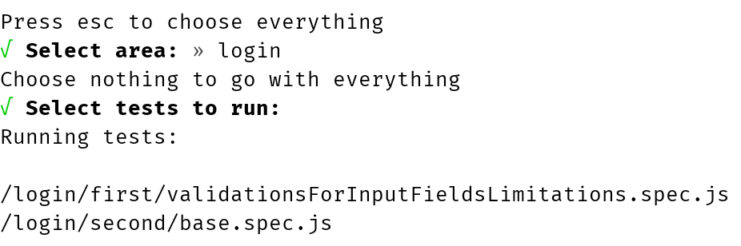
Part 3: How do we trigger test run
Parametrization (dotenv-safe)
How to select specific test or feature or smoke tests?

Slide 8
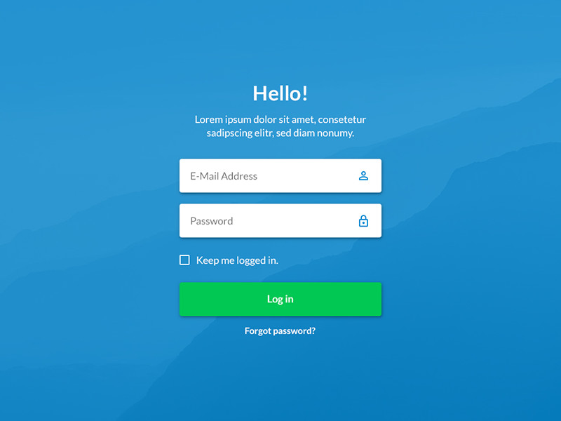
Part 4: Abstraction layers (application)
Notes:
ElementFinder - why do we need it?

Slide 9




Part 4: Tools

Slide 10
Part 4: Abstraction layers (no abstractions)
describe('No abstractions', () => {
it('logs in', async () => {
await driver.element('xpath', `//path/to/login/field`).sendKeys('superUser');
await driver.element('class name', `awesomeClass`).sendKeys('batman');
await driver.element('accessibility id', `keepSignedInCheckbox`).click();
await driver.element('accessibility id', `theButton`).click();
expect(await driver.element('accessibility id', `homeLogo`).isDisplayed())
.toBe(true);
});
});
await browser.sleep(10 * 1000);
await new Promise(resolve => setTimeout(resolve, 10 * 1000));

Slide 11
Part 4: Abstraction layers (Modularity)
Element Finder
Page Elements
Page Objects
Page Actions
Service
Tests
service
.login
.as(admin)
Component
BasePo
BasePa
BaseService
InteractableComponent
LoginPo
LoginPa
LoginService
Table
Button
ElementFinder
LoginPo
LoginPa
Section
InputField
Checkbox
Notes:
ElementFinder - why do we need it?

Slide 12
Part 4: Abstraction layers (responsibility)
Page elements describe components behavior. Like every element can be displayed, button can be clicked, etc.
Page objects consist of page elements representing the page
ElementFinder is a class which is responsible for finding elements on a page
Page actions are representations of what can be done with the page like clickButton, scrollToElement. This is the place for actions logging
Services represent business logic and can include multiple page actions and/or other services
Notes:
ElementFinder - why do we need it?

Slide 13
Part 4: Abstraction layers (Page Elements)
describe('No abstractions', () => {
it('logs in', async () => {
await driver.element('xpath', `//path/to/login/field`).sendKeys('superUser');
await driver.element('class name', `awesomeClass`).sendKeys('batman');
await driver.element('accessibility id', `keepSignedInCheckbox`).click();
await driver.element('accessibility id', `theButton`).click();
expect(await driver.element('accessibility id', `homeLogo`).isDisplayed())
.toBe(true);
});
});
await browser.sleep(10 * 1000);
await new Promise(resolve => setTimeout(resolve, 10 * 1000));

Slide 14
Part 4: Abstraction layers (Page Elements)
class Component {
constructor(protected element) {}
async click() {
await this.element.click();
}
isDisplayed() {
return this.element.isDisplayed();
}
}
class Checkbox extends Component {
constructor(protected element) {
super(element);
}
isChecked() {
return this.element.isChecked();
}
async check() {
await this.isChecked() || await this.click();
}
}
class Button extends Component {
constructor(protected element) {
super(element);
}
}
class InputField extends Component {
constructor(protected element) {
super(element);
}
async sendKeys(text) {
await this.element.sendKeys(text);
}
}

Slide 15
Part 4: Abstraction layers (Page Objects)
class LoginPo {
loginField = new InputField(this.ef.xpath(`//path/to/login/field`));
passwordField = new InputField(this.ef.className(`awesomeClass`));
loginButton = new Button(this.ef.autoId(`theButton`));
keepSignedInCheckbox = new Checkbox(this.ef.autoId(`keepSignedInCheckbox`));
constructor(private ef: ElementFinder) {
}
}

Slide 16
Part 4: Abstraction layers (Page Actions)
describe('No abstractions', () => {
it('logs in', async () => {
await driver.element('xpath', `//path/to/login/field`).sendKeys('superUser');
await driver.element('class name', `awesomeClass`).sendKeys('batman');
await driver.element('accessibility id', `keepSignedInCheckbox`).click();
await driver.element('accessibility id', `theButton`).click();
expect(await driver.element('accessibility id', `homeLogo`).isDisplayed())
.toBe(true);
});
});
await new Promise(resolve => setTimeout(resolve, 10 * 1000));

Slide 17
Part 4: Abstraction layers (Page Actions)
class LoginPa {
constructor(public page: LoginPo) {}
async enterLogin(login) {
log.info(`Entering login: ${login}`);
await this.page.loginField.sendKeys(login);
}
async enterPassword(password) {
log.info(`Entering password: ${password}`);
await this.page.passwordField.sendKeys(password);
}
async checkKeepSignedInCheckbox() {
log.info(`Checking keep signed in checkbox`);
await this.page.keepSignedInCheckbox.check();
}
async clickSignInButton() {
log.info(`Clicking sign in button`);
await this.page.loginButton.click();
await new Promise(resolve => setTimeout(resolve, 10 * 1000));
}
}

Slide 18
Part 4: Abstraction layers (Services)
describe('Services', () => {
it('logs in', async () => {
await login.enterLogin('superUser');
await login.enterPassword('batman');
await login.checkKeepSignedInCheckbox();
await login.clickSignInButton();
expect(await home.logoIsDisplayed()).toBe(true);
});
});
Let’s talk about BDD
BDD != (cucumber || gherkin)
(cucumber || gherkin) != BDD

Slide 19
Part 4: Abstraction layers (Services)
class LoginService {
async as(user: userInterface) {
const {login, password} = user;
log.info(`Logging in as "${login}"`);
await this.page.enterLogin(login);
await this.page.enterPassword(password);
await this.page.checkKeepSignedInCheckbox();
await this.page.clickSignInButton();
}
}
constructor(public page: LoginPa) {}
constructor(private homeService: HomeService,
public page: LoginPa) {}
What’s missing?
await this.homeService.verifyPageIsOpen();

Slide 20
Part 4: Abstraction layers (Services)
describe('Services', () => {
it('logs in', async () => {
await login.withUser('superUser', 'batman');
expect(await home.page.logoIsDisplayed()).toBe(true);
});
});
Notes:
Now home is service and we have all the properties and methods from page actions and page objects available through single service

Slide 21
User pool - data
function getUsers(): {[name: number]: userInterface} {
return {
10000: {
login: 'superUser',
password: 'batman',
hairColor: 'blond',
height: 171,
},
10001: {
login: 'normalUser',
password: 'megaSecuredPassword_42!',
hairColor: 'brunette',
height: 168,
}
};
}
interface userInterface {
login: string;
password: string;
hairColor: string;
height: number;
}

Slide 22
User pool - service
class UserService implements UserServiceInterface {
private users = getUsers();
private freeUsers = getUsers();
private allocatedUsers = {};
private filteredUsers = [];
private firstFilter = true;
allocate() {
log.info(`Allocating user`);
if (this.filteredUsers.length === 0) {
throw new Error(`No free users with chosen filter parameters.
Free users: ${JSON.stringify(this.freeUsers, null, 4)}
Allocated users: ${JSON.stringify(this.allocatedUsers, null, 4)}`);
}
const [id, user] = this.filteredUsers[0];
const {login, password} = user;
delete this.freeUsers[id];
this.allocatedUsers[id] = user;
this.resetFilter();
log.info(`Allocated user: ${id} - ${login}`);
return {id, login, password, free: () => this.free(id)};
}
blonde() {
log.info(`Filtering blonds`);
this.filter(([id, user]) => user.hairColor === 'blond');
return this;
}
heightMoreThan(height) {
log.info(`Filtering users with height more than: ${height}`);
this.filter(([id, user]) => user.height > height);
return this;
}
any() {
this.filter(() => true);
return this;
}
private filter(predicate) {
this.filteredUsers = this.firstFilter
? (Object as any).entries(this.freeUsers).filter(predicate)
: this.filteredUsers.filter(predicate);
this.firstFilter = false;
}
private free(id) {
log.info(`Freeing user: ${id}`);
delete this.allocatedUsers[id];
this.freeUsers[id] = this.users[id];
}
private resetFilter() {
this.filteredUsers = [];
this.firstFilter = true;
}
}
interface userInterface {
id: number;
login: string;
password: string;
free: () => void;
}

Slide 23
Part 4: Abstraction layers (UserService)
describe('Services', () => {
const blondUserHigher170 = null;
beforeAll(() => user
.blonde()
.heightMoreThan(170)
.allocate());
afterAll(() => blondUserHigher170.free());
it('logs in', async () => {
await login.as(blondUserHigher170);
expect(await home.page.logoIsDisplayed()).toBe(true);
});
});

Slide 24
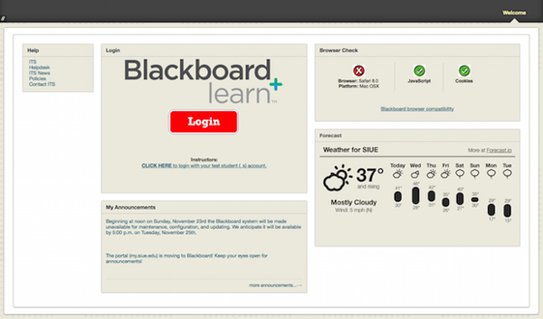

Part 4: Abstraction layers (Services)
One physical page
Lots of logical pages

Slide 25

Part 4: Abstraction layers (Services)
class LoginService extends (LoginPa, WeatherPa) {
}
class LoginService extends WeatherPa {
}
class LoginService {
constructor(private homeService: HomeService,
public page: LoginPa,
public weatherPage: WaetherPa) {
}
}

Slide 26
Part 5: Element Finder (better api)
class ElementFinder {
id(id, options?) {
return driver.element('id', id);
}
autoId(accessibilityId) {
return driver.element('accessibility id', accessibilityId);
}
xpath(xpath) {
return driver.element('xpath', xpath);
}
className(className) {
return driver.element('class name', className);
}
text(text, options = {partial: false}) {
const {partial} = options;
const locator = partial
? `//*[contains(@text, '${text}')]`
: `//*[@text = '${text}']`;
return driver.element('xpath', locator);
}
}
Notes:
Won’t work for iOS

Slide 27
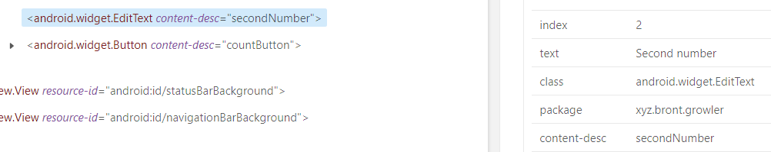
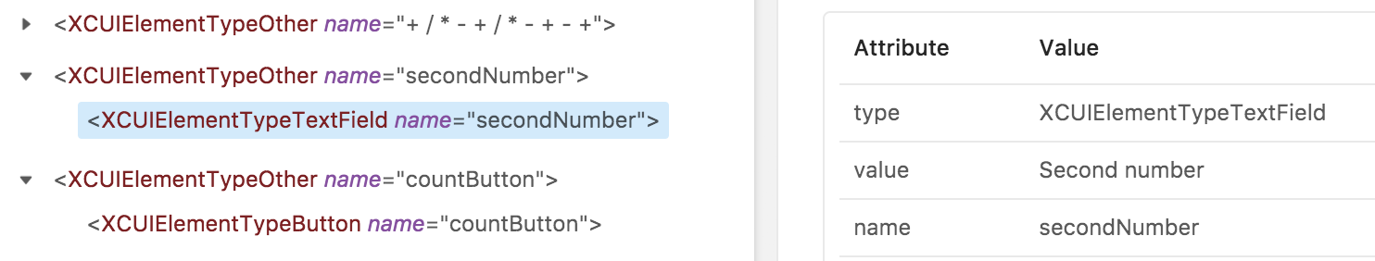
Part 5: Element Finder

Slide 28
Part 5: Element Finder (platforms difference)
class ElementFinder {
constructor(public accessibilityLabelName,
public autoIdAttribute,
protected textTag) {
}
text(text, options = {partial: false}) {
const {partial} = options;
const locator = partial
? `//*[contains(@${this.textTag}, '${text}')]`
: `//*[@${this.textTag} = '${text}']`;
return driver.element('xpath', locator);
}
autoId(id, options = {partial: false}) {
const {partial} = options;
return partial
? driver.element('xpath', `//*[contains(@${this.accessibilityLabelName}, '${id}')]`)
: this.accessibilityId(id);
}
}
Android
const elementFinder = new ElementFinder(
'content-desc',
'contentDescription',
'text');
iOS
const elementFinder = new ElementFinder(
'name',
'name',
'value');
How to search for multiple elements?

Slide 29
Part 5: Element Finder (multiple elements search)
abstract class BaseElementFinder {
protected abstract searchFunction(using: string, value: string, options: any);
protected constructor(public accessibilityLabelName,
public autoIdAttribute,
protected textTag) {
}
id(id, options?) {
return this.searchFunction('id', id, options);
}
}

Slide 30
Part 5: Element Finder (multiple elements search)
class ElementFinder extends BaseElementFinder {
constructor(public accessibilityLabelName, public autoIdAttribute, protected textTag) {
super(accessibilityLabelName, autoIdAttribute, textTag);
}
get all(): ElementsFinder {
return new ElementsFinder(this.accessibilityLabelName, this.autoIdAttribute, this.textTag);
}
protected searchFunction(using, value) {
return driver.element(using, value);
}
}

Slide 31
Part 5: Element Finder (multiple elements search)
class ElementsFinder extends BaseElementFinder {
constructor(public accessibilityLabelName, public autoIdAttribute, protected textTag) {
super(accessibilityLabelName, autoIdAttribute, textTag);
}
protected searchFunction(using, value, options) {
const defaults = {index: null};
const resultingOptions = Object.assign(defaults, options);
const {index} = resultingOptions;
const elements = driver.elements(using, value);
return index !== null ? elements.at(index) : elements;
}
}
interface findElementsByInterface {
index?: number;
}

Slide 32
Part 5: Element Finder (multiple elements search)
class HomePo {
get logo() {
return new Component(this.ef.autoId('homeLogo'));
}
get items() {
return new Button(this.ef.all.id('someItems'));
}
get secondItem() {
return new Button(this.ef.all.id('someItems', {index: 2}));
}
constructor(private ef: ElementFinder) {}
}

Slide 33
Part 5: Element Finder (lazy search)
class ElementFinder extends BaseElementFinder {
protected searchFunction(using: string, value: string) {
return () => driver.element(using, value);
}
}
class Component {
constructor(protected ef) {}
get element() {
return this.ef();
}
async click() {
await this.element.click();
}
}
class HomePo {
logo = new Component(this.ef.autoId('homeLogo'));
constructor(private ef: ElementFinder) {}
}

Slide 34
Part 6: Waiters (implicit wait)
class Component {
constructor(protected ef) {}
get element() {
return (async () => {
const getTime = () => +new Date();
const startTime = getTime();
do {
try {
const foundElement = this.ef();
if (foundElement) {
return foundElement;
}
} catch (err) {
if (!err.message.includes('NoSuchElement')) {
throwUnexpectedError(this.ef, err);
}
}
await helper.dateTime.sleep(100, {ignoreLog: true});
} while (getTime() - startTime < driver.implicitWait);
throwNoSuchElementError(this.ef);
})();
}
async click() {
await (await this.element).click();
}
}

Slide 35
Part 6: Waiters (explicit wait)
async function poll(callback, continuePolling, interval, cbContinueCondition) {
if (!continuePolling()) {
return Promise.reject(`Polling didn't give results.`);
}
const result = await callback();
process.stdout.write(".");
if (result !== cbContinueCondition) {
console.info(); // New line after buffer write
return result;
}
await dateTimeHelper.sleep(interval, {ignoreLog: true});
return poll(callback, continuePolling, interval, cbContinueCondition);
}

Slide 36
Part 6: Waiters (explicit wait)
async wait(callback, timeout, interval = 100): Promise<any> {
const currentTime = () => +new Date();
const startTime = currentTime();
const continuePolling = () => (currentTime() - startTime) < timeout;
return poll(callback, continuePolling, interval, false);
}
async appiumWait(callback, timeout, interval = 100): Promise<any> {
driver.setImplicitTimeout(0);
try {
return await wait(...arguments);
} finally {
driver.setImplicitTimeout(driver.defaultImplicitWait);
}
}

Slide 37
Part 6: Waiters (explicit wait)
async clickSignInButton() {
log.info(`Clicking sign in button`);
await this.loginButton.click();
await new Promise(resolve => setTimeout(resolve, 10 * 1000));
}
describe('Services', () => {
const blondUserHigher170 = null;
beforeAll(() => user
.blonde()
.heightMoreThan(170)
.allocate());
afterAll(() => blondUserHigher170.free());
it('logs in', async () => {
await login.as(blondUserHigher170);
expect(await helper.waiters.appiumWait(() => home.logoIsDisplayed(), 10 * 1000))
.toBe(true);
});
});

Slide 38
Part 7: How to fight platform differences without “if” on each line (assembler)
const elementFinder = new ElementFinder(
'content-desc',
'contentDescription',
'text');
const loginPo = new LoginPo(elementFinder);
const loginPa = new LoginPa(loginPo);
const weatherPo = new WeatherPo(elementFinder);
const weatherPa = new WeatherPa(weatherPo);
const loginService = new LoginService(homeService, loginPa, weatherPa);
Notes:
A lot of imports problem. Let’s leave it for later

Slide 39
Part 7: How to fight platform differences without “if” on each line (assembler)
const elementFinder = new ElementFinder(
'content-desc',
'contentDescription',
'text');
const loginService = helper.assembler.serviceFactory({
elementFinder,
service: LoginService,
parts: [
{po: LoginPo, pa: LoginPa},
{po: WeatherPo, pa: WaetherPa},
],
assebledServices: {homeService}
});
Notes:
A lot of imports problem. Let’s leave it for later

Slide 40
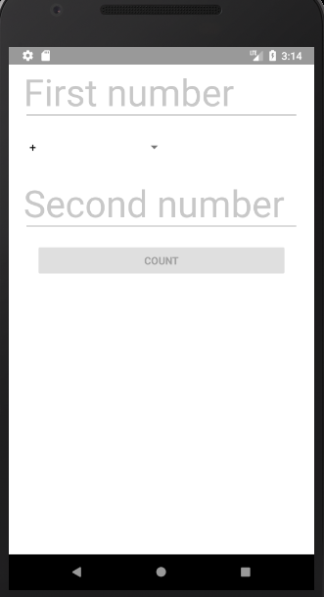
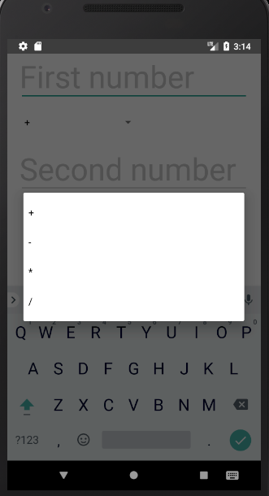
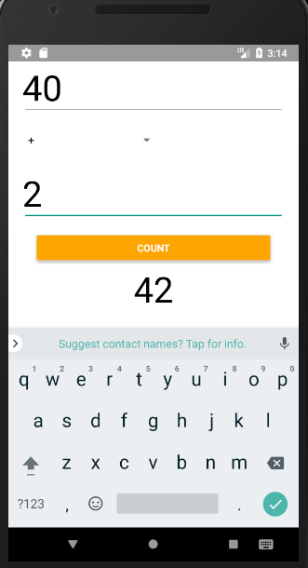
Part 7: How to fight platform differences without “if” on each line

Slide 41
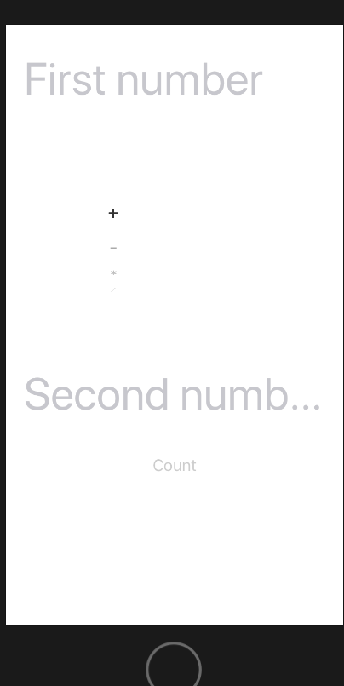
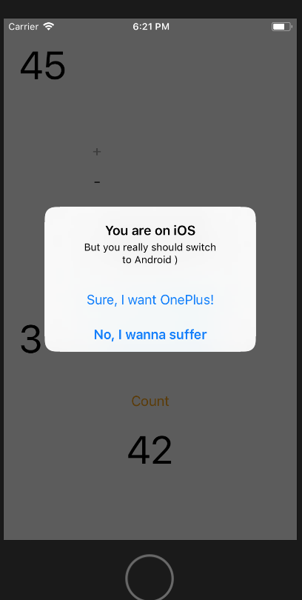
Part 7: How to fight platform differences without “if” on each line
Scroll by coordinates
Button hides under keyboard

Slide 42
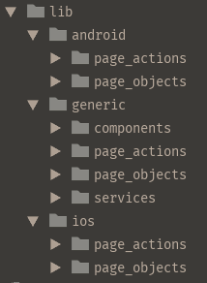
Part 7: How to fight platform differences without “if” on each line
abstract class LoginPo {
loginField = new InputField(this.ef.xpath(`//path/to/login/field`));
passwordField = new InputField(this.ef.className(`awesomeClass`));
loginButton = new Button(this.ef.autoId(`theButton`));
abstract keepSignedInCheckbox: Checkbox;
protected constructor(private ef: ElementFinder) {
}
}

Slide 43
Part 7: How to fight platform differences without “if” on each line
import {LoginPo as GenericLoginPo}
from "../../generic/page_objects/login.po";
class LoginPo extends GenericLoginPo {
keepSignedInCheckbox = new Checkbox(this.ef.autoId(`iOS`));
protected constructor(protected ef: ElementFinder) {
super(ef);
}
}
import {LoginPo as GenericLoginPo} from
from "../../generic/page_objects/login.po";
class LoginPo extends GenericLoginPo {
keepSignedInCheckbox = new Checkbox(this.ef.autoId(`Android`));
protected constructor(protected ef: ElementFinder) {
super(ef);
}
}
How to get it all together

Slide 44
Part 8: Dynamic imports
import {LandingService} from "../../generic/services/landing.service";
import {LandingPa} from "../../generic/page_actions/landing.pa";
import {LandingPo} from "../../generic/page_objects/landing.po";
import {BasicTripInfoPo} from "../../generic/page_objects/travelInfo/basicTripInfo.po";
import {BasicTripInfoService} from "../../generic/services/basicTripInfo.service";
import {BasicTripInfoPa} from "../../generic/page_actions/travelInfo/basicTripInfo.pa";
import {CalendarPa} from "../../generic/page_actions/pickers/calendar.pa";
import {SearchListPo} from "../../generic/page_objects/pickers/searchList.po";
import {SearchListPa} from "../../generic/page_actions/pickers/searchList.pa";
import {CalendarPo} from "../../generic/page_objects/pickers/calendar.po";

Slide 45
Part 8: Dynamic imports
const lib = {
android: {
page_objects: {LoginPo}
},
generic: {
page_objects: {LoginPo, HomePo},
page_actions: {LoginPa, HomePa},
service: {LoginService, HomeService}
},
ios: {
page_objects: {LoginPo}
}
}
build() {
log.info(`Building lib`);
const lib = {};
const libDir = `${__dirname}/../lib`;
const platforms = fs.readdirSync(libDir);
platforms.forEach(platform => {
lib[platform] = {};
const libTypes = fs.readdirSync(`${libDir}/${platform}`);
libTypes.forEach(libType => {
lib[platform][libType] = {};
fsHelper.getFilesRecursively(`${libDir}/${platform}/${libType}`)
.forEach(async file => {
const className = getClassName(file);
lib[platform][libType][className] = null;
const importedFile = await import(file);
lib[platform][libType][className] = importedFile[className];
});
});
});
const {
page_objects: {LoginPo, HomePo},
page_actions: {LoginPa, HomePa},
service: {LoginService, HomeService}
} = lib.generic;

Slide 46
Part 8: Dynamic imports
function assembleServices(elementFinder, lib) {
const {
page_objects: {
LoginPo,
HomePo,
},
page_actions: {
LoginPa,
HomePa,
},
services: {
LoginService,
HomeService,
}
} = lib;
const homeService = helper.assembler.serviceFactory({
elementFinder,
service: HomeService,
parts: [{po: HomePo, pa: HomePa}],
});
return {
login: helper.assembler.serviceFactory({
elementFinder,
service: LoginService,
parts: [{po: LoginPo, pa: LoginPa}],
assembledServices: {homeService}
}),
home: homeService,
}

Slide 47
Part 8: Dynamic imports
function assembleAndroid() {
const elementFinder = new ElementFinder('content-desc',
'contentDescription', 'text');
Object.assign(helper.lib.all.generic.page_objects, helper.lib.all.android.page_objects);
Object.assign(helper.lib.all.generic.page_actions, helper.lib.all.android.page_actions);
return assembleServices(
elementFinder,
helper.lib.all.generic);
}
const lib = {
android: {
page_objects: {LoginPo}
},
generic: {
page_objects: {LoginPo, HomePo},
page_actions: {LoginPa, HomePa},
service: {LoginService, HomeService}
},
ios: {
page_objects: {LoginPo}
}
}

Slide 48
Part 8: Overview scheme
LoginService
LoginPa
LoginPo
ElementFinder
elementFinder
const {
page_objects: {LoginPo, WeatherPo},
page_actions: {LoginPa, WeatherPa},
service: {LoginService}
} = lib.generic;
.env
platform=Android
Service Factory
WeatherPa
WeatherPo
ElementFinder

Slide 49
Part 9: How to check that page opened
class BasePa {
protected page;
isOpen(params: isOpenInterface = {timeout: 20 * 1000}) {
const {timeout} = params;
return this.checkElementsDisplayed(
this.page.staticElements,
timeout,
'page is opened');
}
private checkElementsDisplayed(elements, timeout, logMessage) {
const isDisplayedArr = [];
log.info(`Checking if "${this.page.name}" ${logMessage}`);
isDisplayedArr.push(...elements
.map(element => element.waitUntilDisplayed(timeout)
.catch(() => false)));
return helper.promise.allTrue(isDisplayedArr);
}
}
abstract class BasePo {
abstract name;
abstract get staticElements();
}

Slide 50
Part 9: How to check that page opened
class HomePo extends BasePo {
name = 'HomePo';
logo = new Component(this.ef.autoId('homeLogo'));
constructor(private ef: ElementFinder) {}
get staticElements() {
return [this.logo];
}
}

Slide 51
Part 9: How to check that page opened (physical page)
class BaseService {
protected staticLogicalPages = [];
protected page;
async pageIsOpen(params = {timeout: 30 * 1000}) {
log.info(`Checking if physical "${this.page.page.name}" page is open`);
const isOpenArr = [this.page.isOpen(params)];
for (const page of this.staticLogicalPages) {
isOpenArr.push(page.isOpen(params));
}
return helper.promise.allTrue(isOpenArr);
}
}
class LoginService {
protected staticLogicalPages = [this.weatherService.page];
constructor(private homeService: HomeService,
public weatherService: WeatherService,
public page: LoginPa) {}
}

Slide 52
Part 10: Automate automation (skeleton) - po
Let’s create login skeleton from scratch
Create file login.po.ts in lib/generic/page_objects folder
Import ElementFinder and BasePo
Create class LoginPo with interface and inheritance from BasePo
Don’t forget to export it
Create constructor with ef: ElementFinder
Create name and staticElements properties

Slide 53
Part 10: Automate automation (skeleton) - po
import {ElementFinderInterface} from "../../../helpers/element_finder/elementFinder.helper";
import {BasePo} from "./base.po";
interface LoginPoInterface extends BasePo {}
class LoginPo extends BasePo implements LoginPoInterface {
name = 'LoginPo';
constructor(private ef: ElementFinderInterface) {
super();
}
get staticElements() {
return [];
}
}
export {LoginPo};

Slide 54
Part 10: Automate automation (skeleton) - pa
Create file login.pa.ts in lib/generic/page_actions folder
Import BasePa, helper for logger and LoginPo
Create class LoginPa with interface and inheritance from BasePa
Don’t forget to export it
Create constructor with page: LoginPo
Create logger

Slide 55
Part 10: Automate automation (skeleton) - pa
import {LoginPo} from "../page_objects/login.po";
import {helper} from "../../../helpers/helper";
import {BasePa} from "./base.pa";
const log = helper.logger.get('LoginPa');
interface LoginPaInterface extends BasePa {}
class LoginPa extends BasePa implements LoginPaInterface {
constructor(public page: LoginPo) {
super();
}
}
export {LoginPa};

Slide 56
Part 10: Automate automation (skeleton) - service
Create file login.service.ts in lib/generic/service folder
Import BaseService, helper for logger and LoginPa
Create class LoginService with interface and inheritance from BaseService
Don’t forget to export it
Create constructor with page: LoginPa
Create logger

Slide 57
Part 10: Automate automation (skeleton) - service
import {LoginPa} from "../page_actions/Login.pa";
import {BaseService} from "./base.service";
import {helper} from "../../../helpers/helper";
const log = helper.logger.get('LoginService');
interface LoginServiceInterface extends BaseService {}
class LoginService extends BaseService implements LoginServiceInterface {
constructor(public page: LoginPa) {
super();
}
}
export {LoginService};

Slide 58
Part 10: Automate automation (platform difference)
Create files login.po.ts in corresponding lib/ios and lib/android folders (e.g. original class lives in lib/generic/page_objects/login/login.po.ts then folders are: lib/android/page_objects/login/login.po.ts and lib/ios/page_objects/login/login.po.ts)
Import ElementFinder and generic LoginPo
Rename login po in import: LoginPo as GenericLoginPo (we need original name to export for merging in assembler)
Create class LoginPo with interface and inheritance from GenericLoginPo
Don’t forget to export it
Create constructor with ef: ElementFinder

Slide 59
Part 10: Automate automation (platform difference)
import {ElementFinderInterface} from "../../../helpers/element_finder/elementFinder.helper";
import {LoginPo as GenericLoginPo} from "../../generic/page_objects/login.po";
interface LoginPoInterface extends GenericLoginPo {}
class LoginPo extends GenericLoginPo implements LoginPoInterface {
constructor(protected ef: ElementFinderInterface) {
super(ef);
}
}
export {LoginPo};

Slide 60
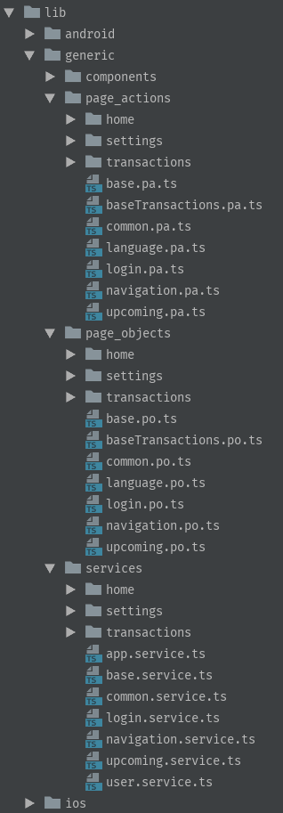

Part 10: Automate automation (code generator)

Slide 61
Part 10: Automate automation (code generator)
import {ElementFinderInterface} from "../../../../helpers/element_finder/elementFinder.helper";
import {BasePo} from "../base.po";
interface LoginPoInterface extends BasePo {
}
class LoginPo extends BasePo implements LoginPoInterface {
constructor(private ef: ElementFinderInterface) {
super();
}
get staticElements() {
return [this.];
}
}
export {LoginPo};

Slide 62

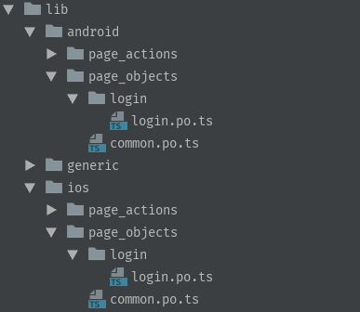
Part 10: Automate automation (code generator)

Slide 63
Part 0: Warm-up (explanation)
NaN === NaN
1 < 2 < 3
false
true
0.2 + 0.1 == 0.3
3 > 2 > 1
false
false
0.15 + 0.15 == 0.3
[] == []
true
false
0,5 + 0,5
[] == ![]
5
true

Slide 64

Part -1: Chat
https://goo.gl/kLqnwF

Slide 65

Part -1: Repo
https://goo.gl/4XoVv6

Slide 66

Part -1: The End

